Slide 1
Gun Control & Gun Violence

Slide 2
Primary Question
Do stricter firearm control laws help reduce firearm mortality?
To answer this, I will use
CDC data detailing age-adjusted firearm mortality rates across the U.S. from 2018 to 2022
Giffords.org’s data on gun law strength rankings across the U.S. from 2018 to 2022
Range from F to A
Notes:
https://wonder.cdc.gov/mcd.html
https://giffords.org/lawcenter/resources/scorecard/

Slide 3

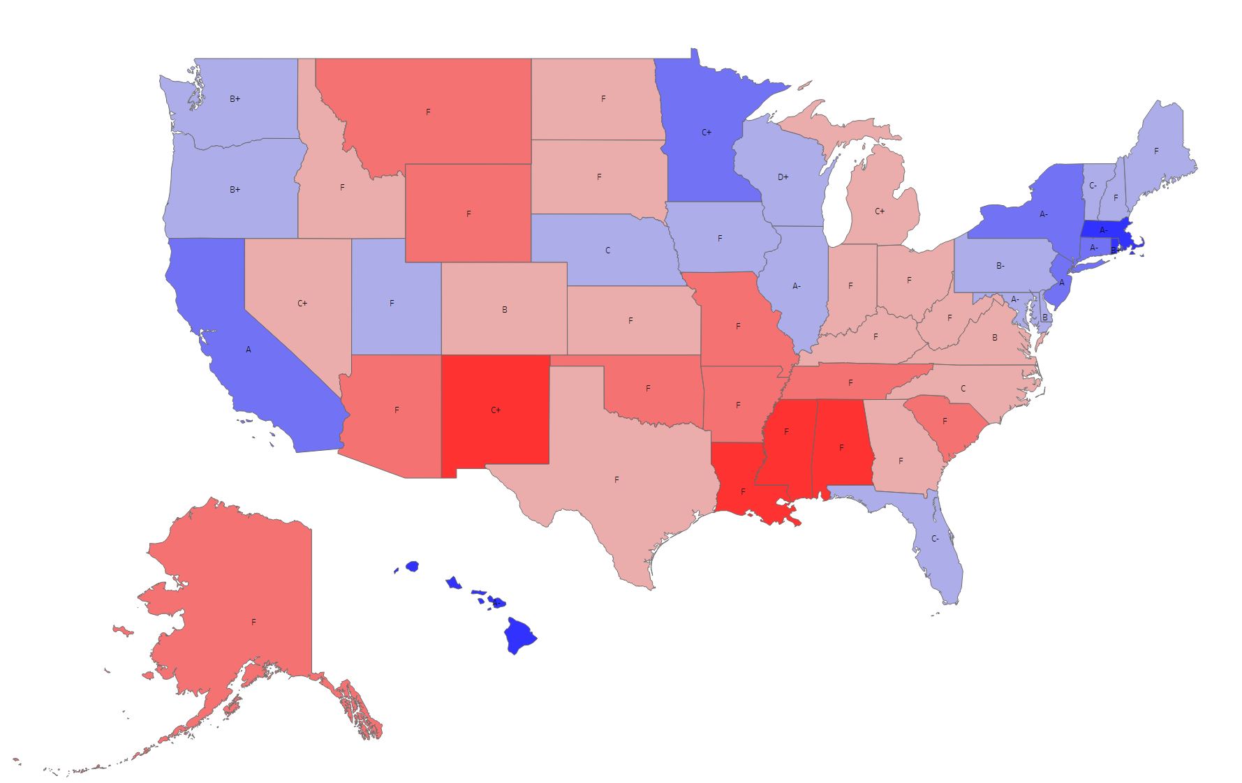
Heatmap of Age Adjusted Death Rates by State and Glifford Ranking in 2022

Slide 4
Interpretations
Although there are exceptions, states with stricter gun laws tend to have fewer reported firearm-related deaths in the year 2022
States with less strict laws tend to have more firearm-related deaths

Slide 5
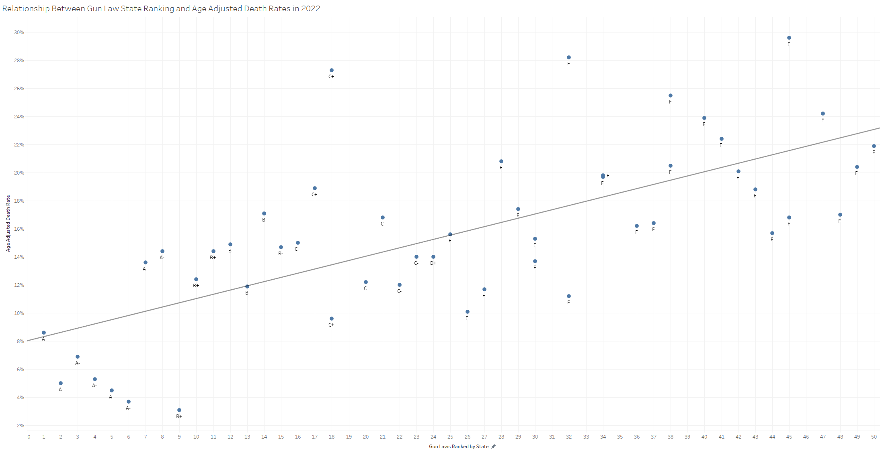

Slide 6
Interpretations
Based on this scatterplot
We can see that states with higher rankings (i.e., closer to 1) tended to have lower overall firearm-related death rates in 2022
Those with lower gun law rankings (i.e., closer to 50) tended to have higher overall firearm-related death rates in 2022
This finding is supported by the regression trendline showing a linear trend such that lower ratings predict higher death rates
Notably, effects are stronger for those with the highest gun control rankings

Slide 7
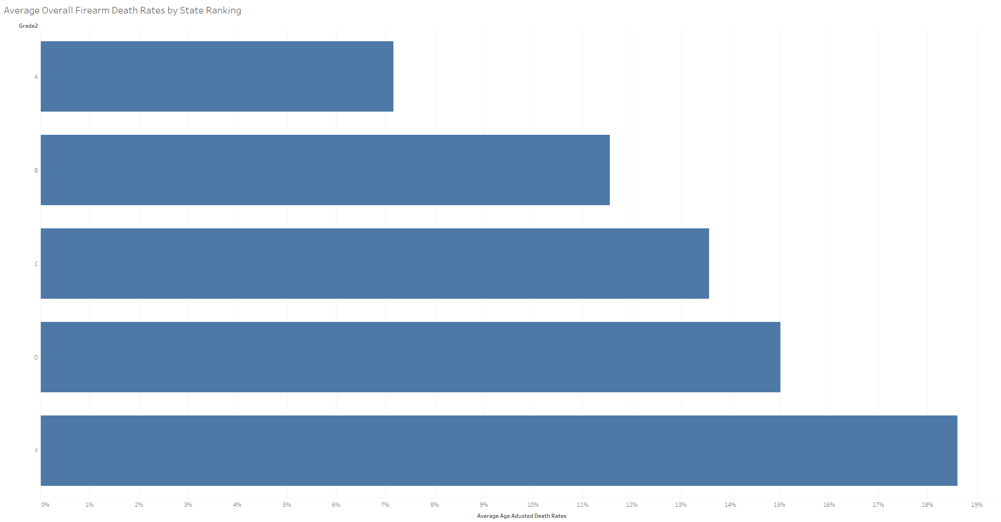
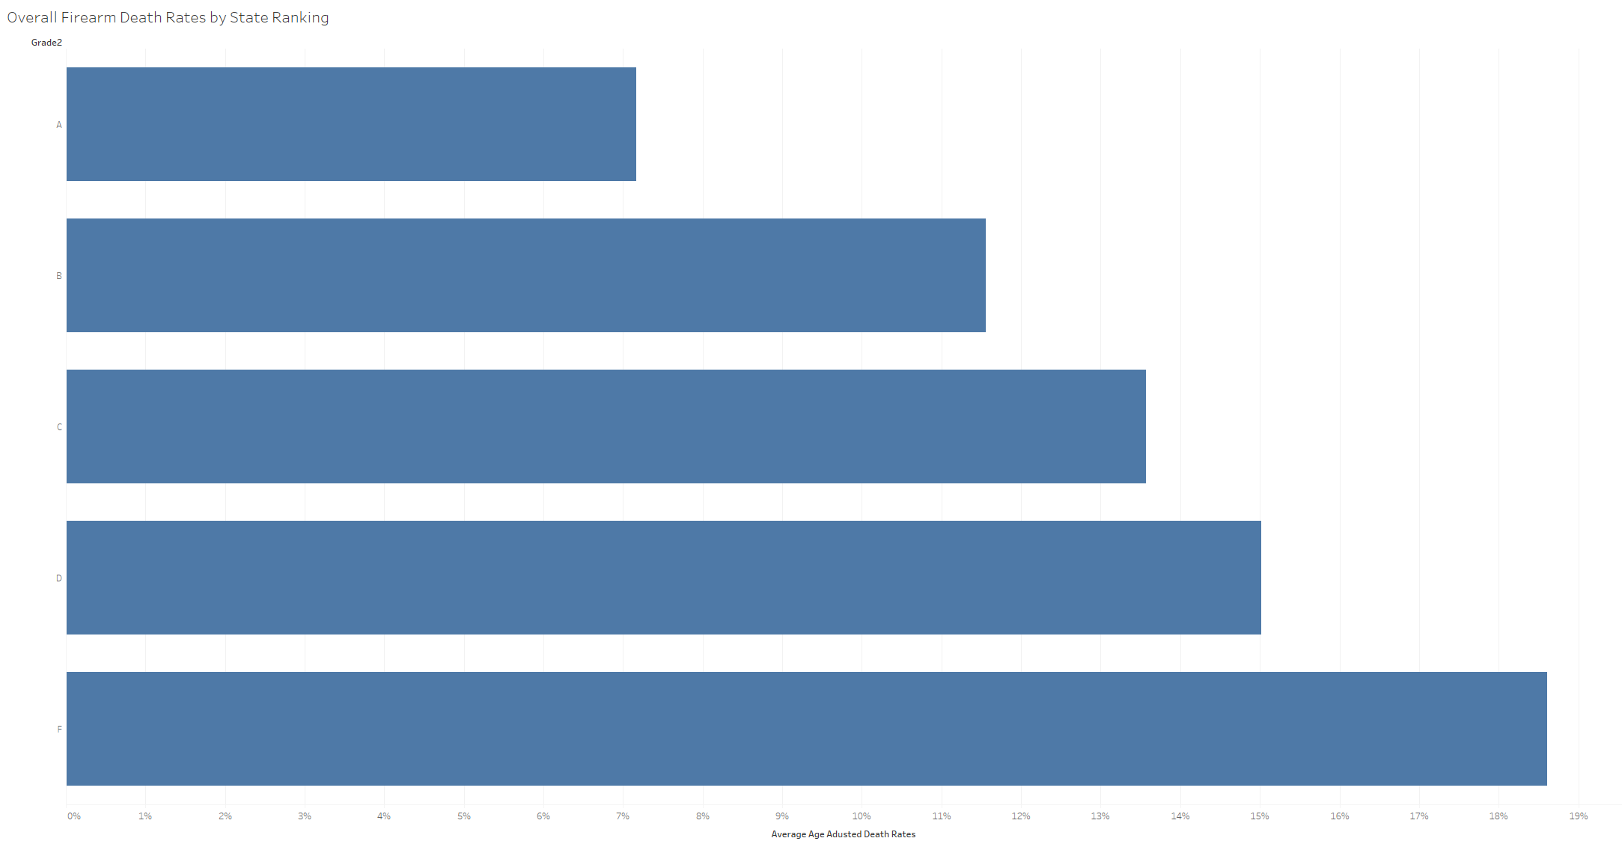
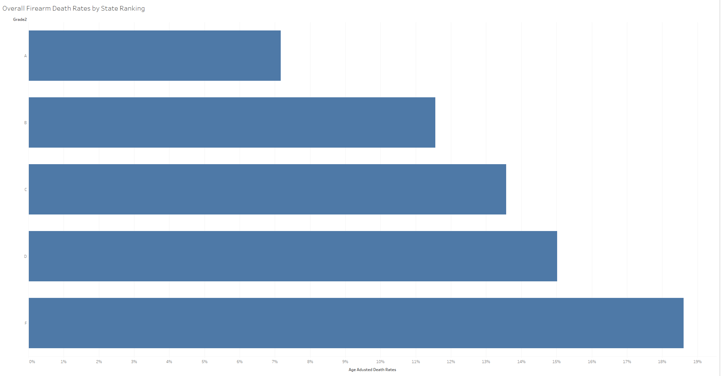

Slide 8
Interpretations
Overall, from 2018 to 2022, states with the most lenient gun laws (grade F) tend to have higher average death rates related to gun violence
On the other hand, those with the strictest ratings (A) tend to have the lowest average death rates

Slide 9

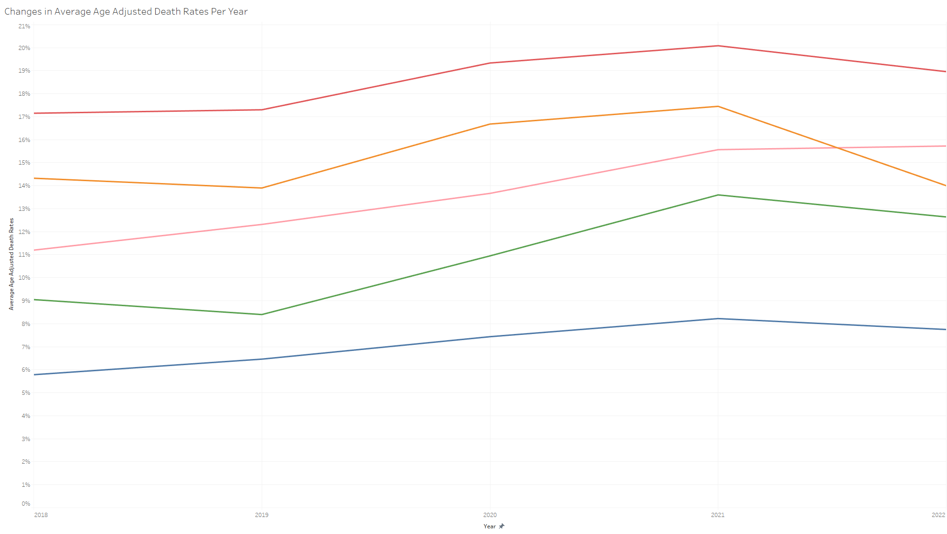

Slide 10
Interpretations
Similar to the bar graph shown previously
On average, states that received an F grade tended to consistently have higher death rates over time
Similarly, those with an A grade, on average, reported lower death rates over time
Trends are consistent for those that received D, C, and B grades
However, there is notably greater variation among these categories over time, especially those receiving a B grade

Slide 11
But What Happens when a State Actually Changes its Gun Laws?
Now, to establish whether changes in gun control laws have any effect on firearm-related deaths
I will examine how states that changed their firearm laws within the 2018-2022 timespan reported changes in death rates following implementation
The following states modified their gun laws at least once within this period:
Colorado
Illinois
Nevada
New Mexico
Utah
Vermont

Slide 12
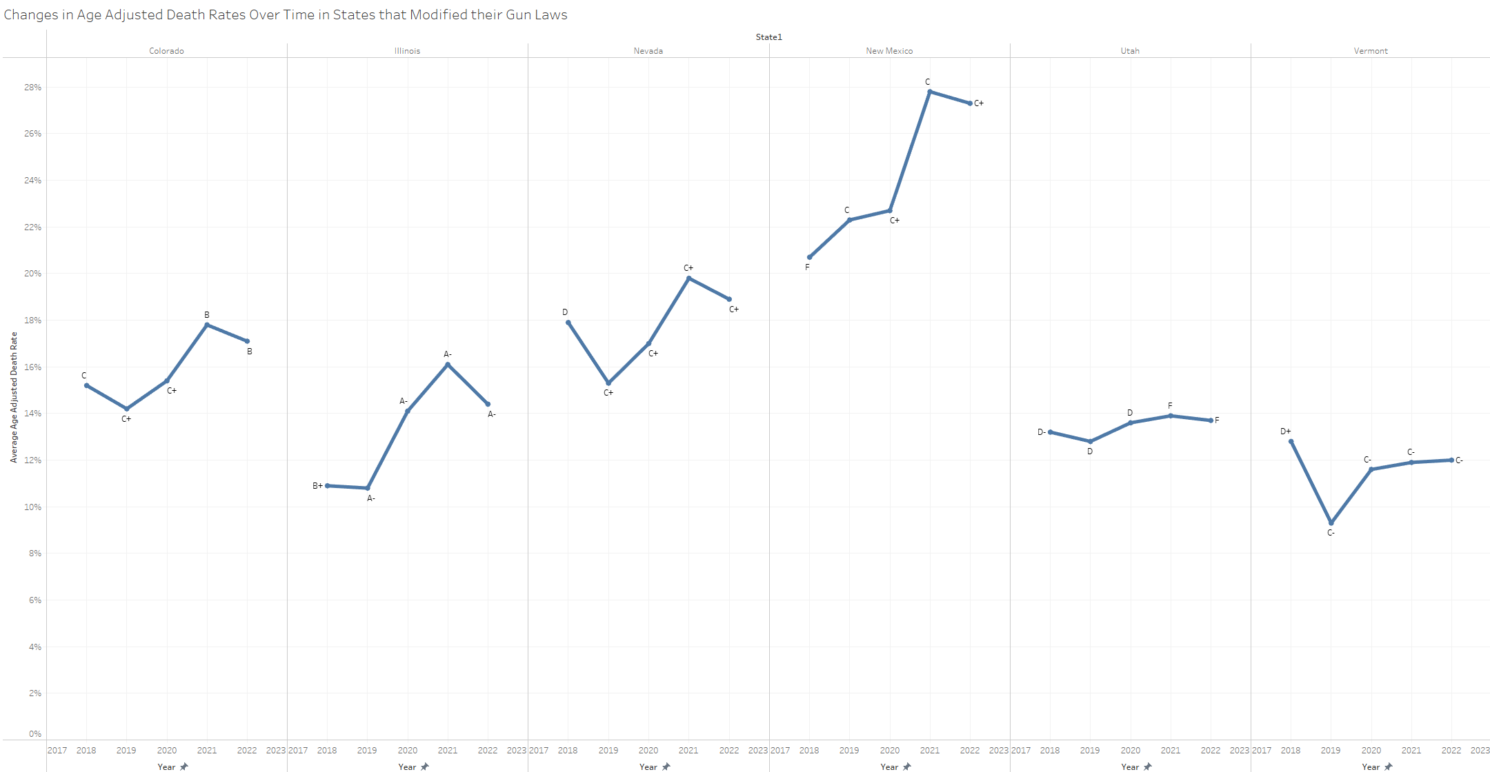

Slide 13
Interpretations
Interestingly, most states that increased the strictness of their gun laws
Reported increased average death rates over time
This is most apparent in New Mexico and Illinois
However, Utah’s average gun death rates slightly increased following decreases in gun law strictness
This may suggest that:
There are factors outside of gun law strictness that impact death rates in certain states
It takes time to see actionable changes after modifying laws

Slide 14
Conclusions
Based on the evidence presented
States with stricter gun control laws tend to have lower firearm-related death rates
This trend is consistent across time
However, states that tightened their gun laws did not see noticeable decreases in firearm-related deaths over time
In fact, some reported increased death rates
Overall, these findings do suggest that stricter gun control laws impact firearm-related deaths
However, it is clear that there are more factors at work that moderate this relationship, and these factors deserve further research
I.e., Culture, political affiliation, local adoption of state regulations

